Slide 1




Brand Platform
www.Fermat.org
@Fermat_ORG
Github.com/Fermat-ORG

Slide 2



What do we believe?
www.Fermat.org
@Fermat_ORG
Github.com/Fermat-ORG

Slide 3
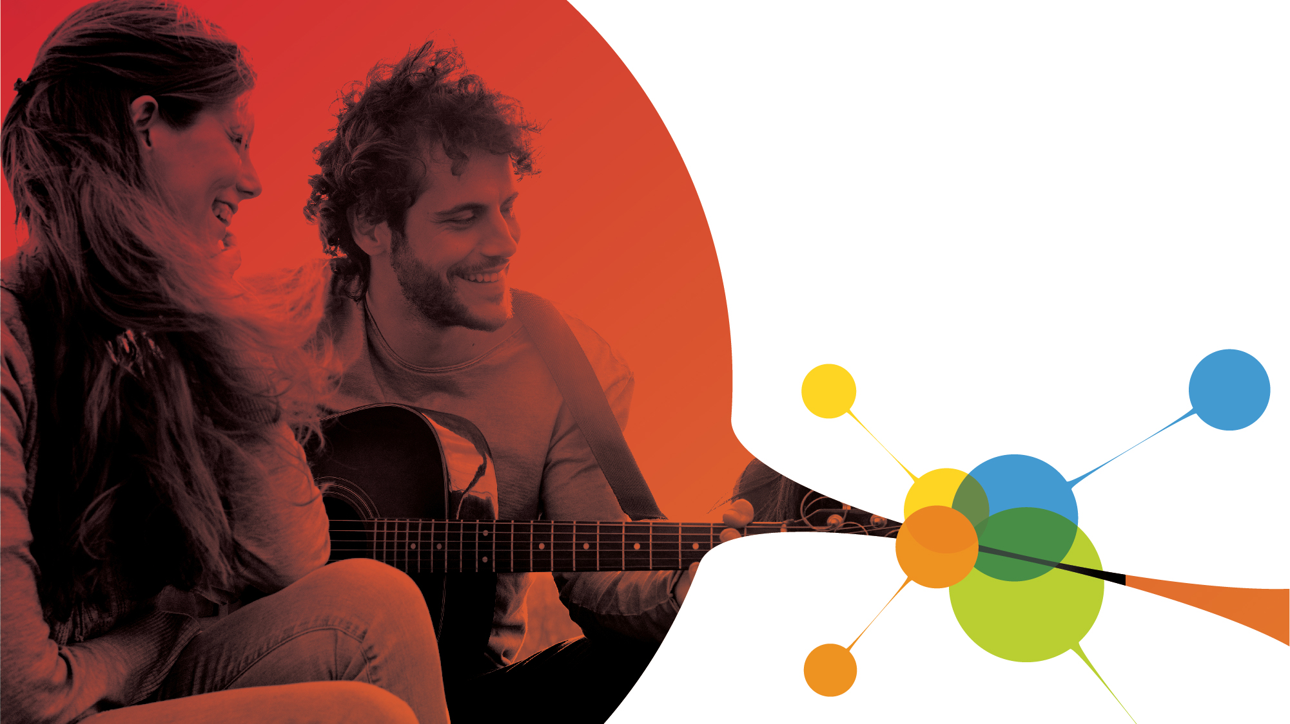
Everything the Fermat Project does is because we believe in a future where people are more important than machines, companies, or nation-states.
www.Fermat.org
@Fermat_ORG
Github.com/Fermat-ORG

Slide 4

How will
we make
this future a reality?
www.Fermat.org
@Fermat_ORG
Github.com/Fermat-ORG

Slide 5



Everything we build is specifically designed to help people:
1
2
3
Cut out any unnecessary middlemen to enable a
person-to-person economy
Increase
trust in others
Provide the right incentives for behavior

Slide 6






We are offering the Internet of People to help organizations scale globally and cost-effectively through the world’s only infrastructure with:
Open Social
Graph (Graphchain)
Device-to-Device Communication
(Redtooth)
Direct Access
to People
(P2P Apps)
Notes:
the Internet of People, which is the world’s only infrastructure with an open social graph (Graphchain), device to device communication (Redtooth), and direct access to people (P2P economy) to help any organization that wants to
cost-effectively scale globally.

Slide 7

Positioning
www.Fermat.org
@Fermat_ORG
Github.com/Fermat-ORG

Slide 8

Positioning
It’s the World Wide Web, only with people, not machines, at the center
www.Fermat.org
@Fermat_ORG
Github.com/Fermat-ORG

Slide 9
Persona How We Act
www.Fermat.org
@Fermat_ORG
Github.com/Fermat-ORG

Slide 10
Persona: How We Act
We just love people
We’re determined to help
We’re just a little bit crazy
www.Fermat.org
@Fermat_ORG
Github.com/Fermat-ORG

Slide 11
Emotion
How We Want Others To Feel
www.Fermat.org
@Fermat_ORG
Github.com/Fermat-ORG

Slide 12
Emotion: How We Want Others To Feel
Uplifted by a sense of possibility
Like they have a “calling” to join us to achieve their purpose
“At home” with us. Harmonious
www.Fermat.org
@Fermat_ORG
Github.com/Fermat-ORG

Slide 13

Signature
How We Talk About Ourselves to the World
www.Fermat.org
@Fermat_ORG
Github.com/Fermat-ORG
Notes:
https://docs.google.com/document/d/1qpfTGKDVFwpC1oegww5nUkxTlna2wJfsTJrtyGAt8JU/edit

Slide 14
Signature
Fermat: Because people are more important than machines
www.Fermat.org
@Fermat_ORG
Github.com/Fermat-ORG

Slide 15
Style Guide
www.Fermat.org
@Fermat_ORG
Github.com/Fermat-ORG

Slide 16
Recommended Fonts
Century Gothic
https://github.com/Fermat-ORG/media-kit/
www.Fermat.org
@Fermat_ORG
Github.com/Fermat-ORG

Slide 17
Logos
https://github.com/Fermat-ORG/media-kit/
www.Fermat.org
@Fermat_ORG
Github.com/Fermat-ORG

Slide 18
Color Palette
Coming Soon…
www.Fermat.org
@Fermat_ORG
Github.com/Fermat-ORG

Slide 19
Brand Platform
www.Fermat.org
@Fermat_ORG
Github.com/Fermat-ORG

